Slide 1
Cost Accounting Prepared by
        Sreevidhya S
        Assistant Professor
        Dept. of Commerce
        NSS College, Pandalam

Slide 2
COST – MEANING
Cost means the amount of expenditure ( actual or notional) incurred on, or attributable to, a given thing.

Slide 3

Cost accounting is concerned with recording, classifying and summarizing costs for determination of costs of products or services, planning, controlling and reducing such costs and furnishing of information to management for decision making

Slide 4

“Cost accountancy” as the application of costing and cost accounting principles, method and techniques to the science, art and practice of cost control and the ascertainment of profitability

Slide 5

Ascertainment of costs
Estimation of costs
Cost control
Cost reduction
Determining selling price
Facilitating preparation of financial and other statement
Providing basis for operating policy

Slide 6

COST: Cost means the amount of expenditure incurred on a particular thing.
COSTING: Costing means the process of ascertainment of costs.
COST ACCOUNTING: The application of cost control methods and the ascertainment of the profitability of activities carried out or planned”.
COST CONTROL: Cost control means the control of costs by management. Following are the aspects or stages of cost control.
JOB COSTING: It helps in finding out the cost of production of every order and thus helps in ascertaining profit or loss made out on its execution. The management can judge the profitability of each job and decide its future courses of action.
BATCH COSTING: Batch costing production is done in batches and each batch consists of a number of units, the determination of optimum quantity to constitute an economical batch is all the more important.

Slide 7

Element of cost
Materials Labour Expenses
Direct Indirect
Direct Indirect
Direct Indirect

Slide 8
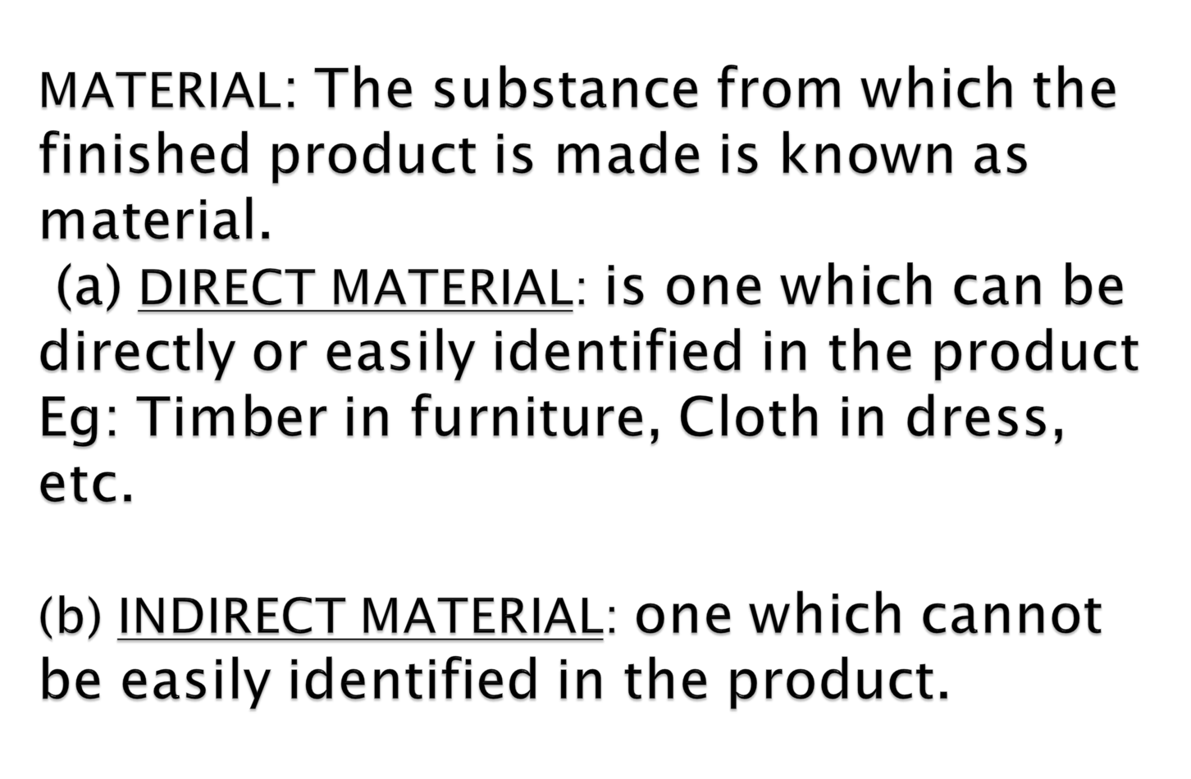

Slide 9

At factory level – lubricants, oil, consumables, etc.
At office level – Printing & stationery, Brooms, Dusters, etc.
At selling & dist. level – Packing materials, printing & stationery, etc.

Slide 10
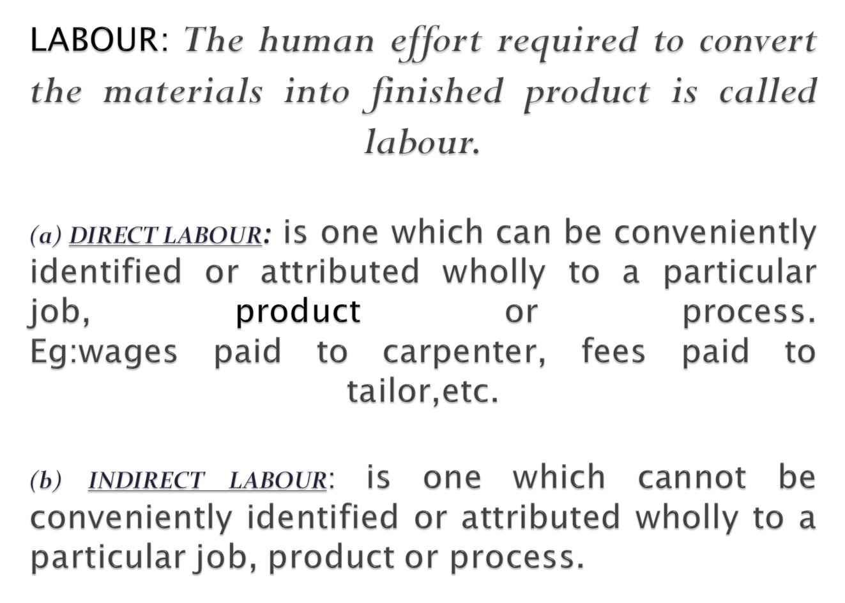

Slide 11


At factory level – foremen’s salary, works manager’s salary, gate keeper’s salary,etc
At office level – Accountant’s salary, GM’s salary, Manager’s salary, etc.
At selling and dist.level – salesmen salaries, Logistics manager salary, etc.

Slide 12
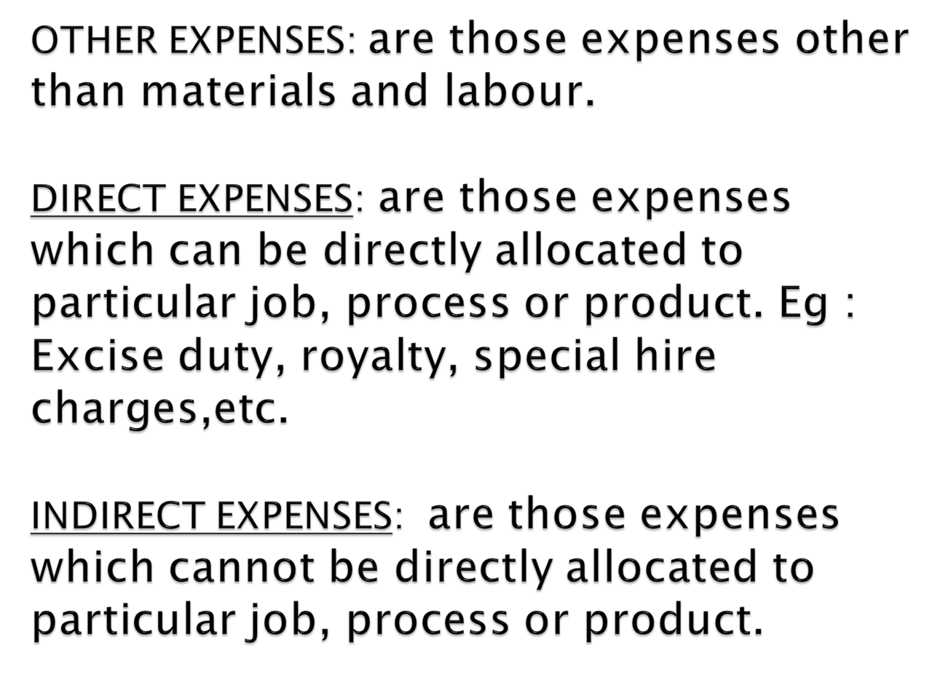

Slide 13

At factory level : factory rent, factory insurance, lighting, etc.
At office level : office rent, office insurance, office lighting, etc.
At sales & dist.level : advertising, show room expenses like rent, insurance, etc.

Slide 14

Classification On basis of :
Nature
Function
Direct & indirect
Variability
Controllability
Normality
Financial accounting classification
Time
Planning and control
Managerial decision making

Slide 15

Materials
Labor
Expenses

Slide 16

Manufacturing costs
Commercial costs – ADM and S&D Costs
ON THE BASIS OF DIRECT AND INDIRECT
Direct costs
Indirect costs

Slide 17

Fixed costs
Variable costs
Semi variable costs

Slide 18

Controllable costs
Uncontrollable costs
ON THE BASIS OF NORMALITY
Normal costs
Abnormal costs
Notes:
College Of Business Administration - Jazan University
Trabelsi Slaheddine (c) 2013

Slide 19

Capital costs
Revenue costs
Deferred revenue costs

Slide 20

Historical costs
Pre determined costs
ON THE BASIS OF PLANNING AND CONTROL:
Budgeted costs
Standard costs

Slide 21

Marginal costs
Out of pocket costs
Sunk costs
Imputed costs
Opportunity costs
Replacement costs
Avoidable costs
Unavoidable costs
Relevant and irrelevant costs
Differential costs

Slide 22
Thank You

